Slide 1
Introduction to Arduino and Robotics
The cardboard box for geeks

Slide 2
Robot
a mechanism guided by automatic controls
Mechanism
Motors
Guided
Sensors
Automatic Controls
Microprocessor (Arduino)
Code

Slide 3
Robot
Hardware
Microprocessor
Sensors
Motors
Power
Software
Code

Slide 4
Robot
Hardware
Microprocessor
Sensors
Motors
Power
Software
Code

Slide 5
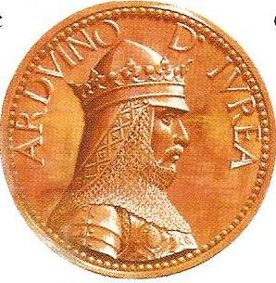
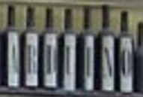
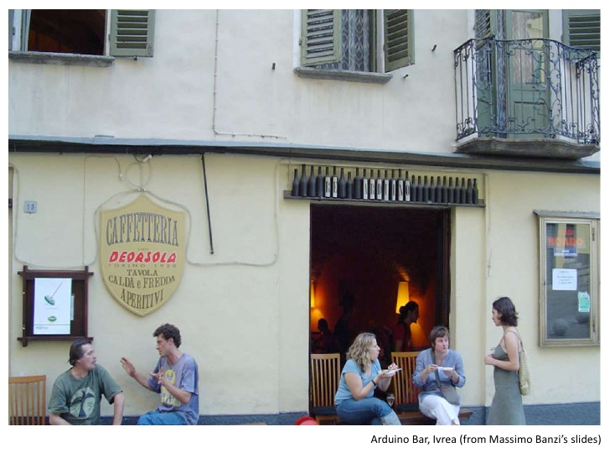
In The Beginning…
The first Arduino
955 – 1015 A.D
King of Italy 1002-1014
Arduino Namesake
Bar in Ivrea Italy

Slide 6
Arduino Microprocessor
Designed by 5 students
Goals
Affordable
Open Source
Easy to program for beginners

Slide 7
Arduino Microprocessor – Success!
Goals
Affordable
< $30
Open Source
Creative Commons license
Easy to program for beginners
700,000 + Official Arduino Boards sold (2013)

Slide 8
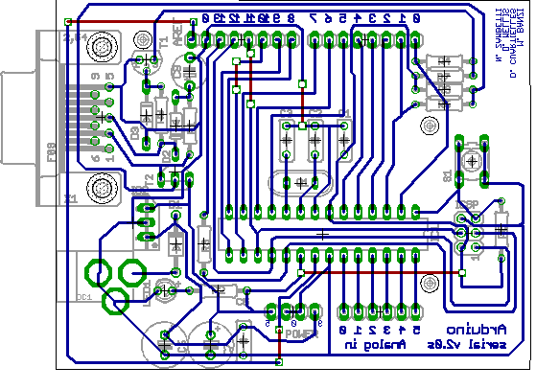
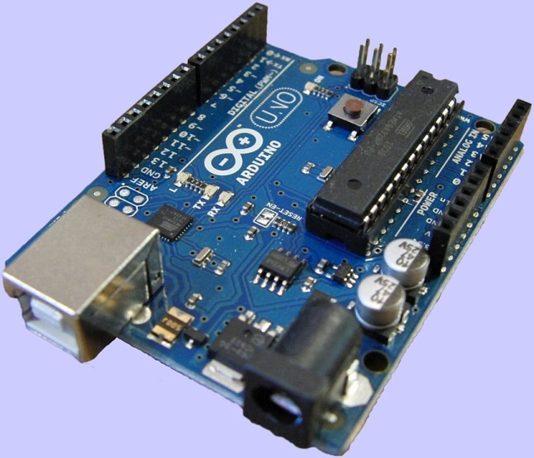
Arduino As We Know It
Arduino (2005)
First board / design
Arduino Uno (2010)
R3 Released 2013

Slide 9
Arduino Boards
Arduino Uno R3
Arduino Yun (linux and Wifi built in)
Trinket Pro (Arduino compatible)
Shields
Motor / Servo controllers
BlueTooth LTE
GPS
Data Logging
Many more!

Slide 10
Arduino
But what can it do?

Slide 11
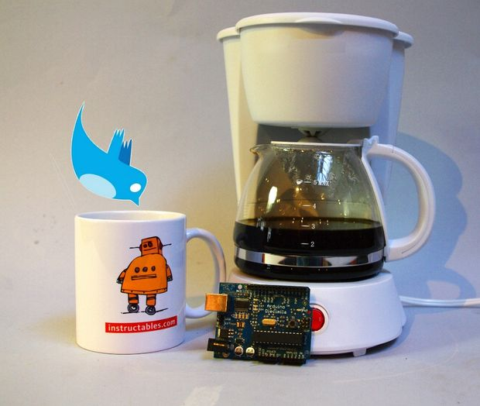
The Cardboard Box for Geeks
Twitter enabled coffee maker.

Slide 12
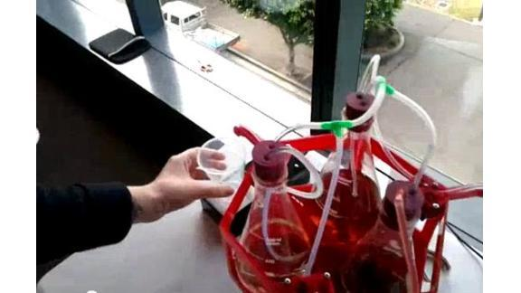
The Cardboard Box for Geeks
Remote Bartender.

Slide 13
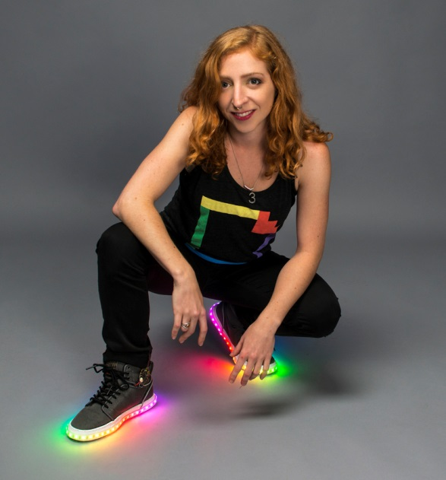
The Cardboard Box for Geeks
Shoes that flash when you walk.

Slide 14
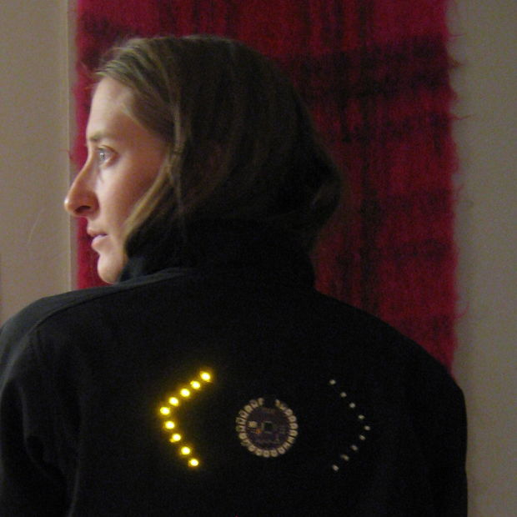
The Cardboard Box for Geeks
Turn Signal Jacket.

Slide 15
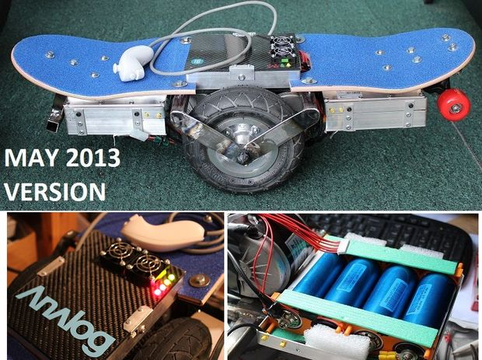
The Cardboard Box for Geeks
Segway style skateboard.

Slide 16
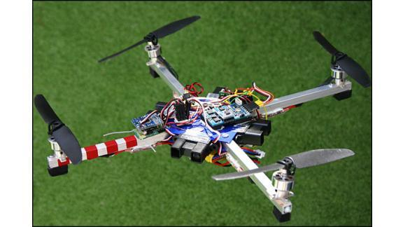
The Cardboard Box for Geeks
Quadcopters!

Slide 17
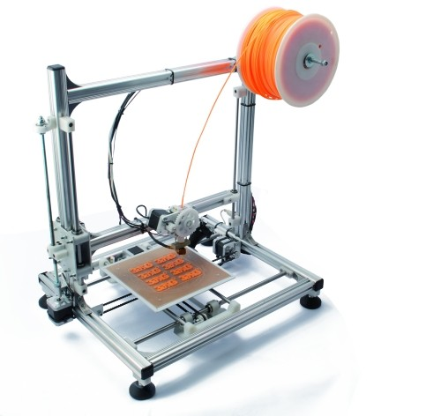
The Cardboard Box for Geeks
3D Printers!

Slide 18
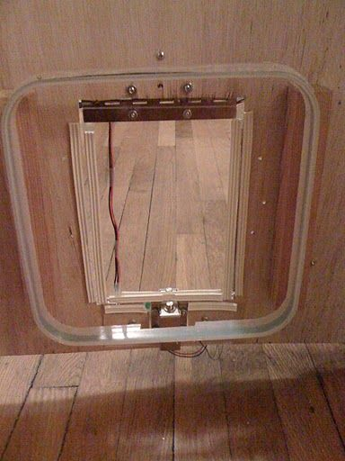
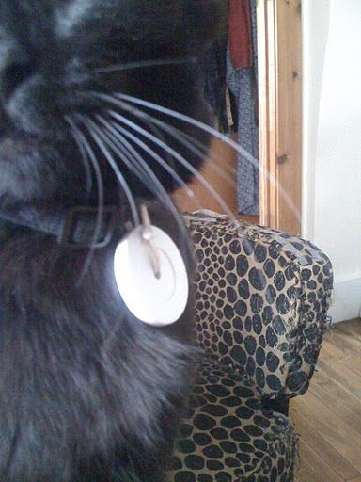
The Cardboard Box for Geeks
RFID Cat Door

Slide 19
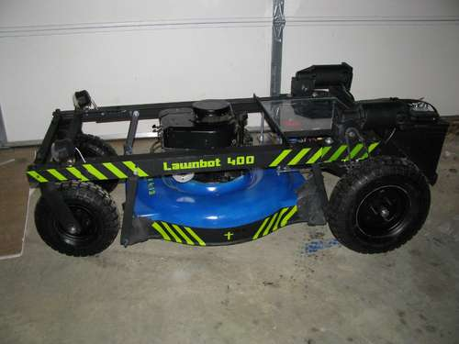
The Cardboard Box for Geeks
Remote Controlled Lawnmower.

Slide 20
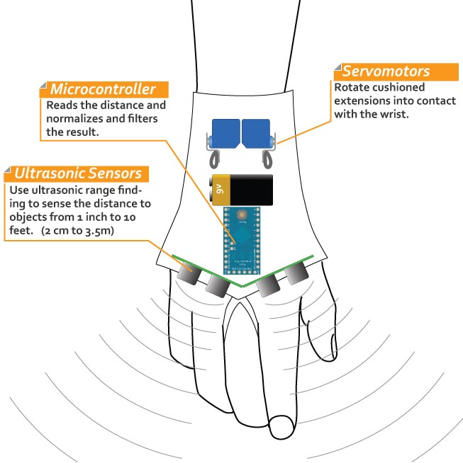
The Cardboard Box for Geeks
Sonic Glove for the blind.

Slide 21
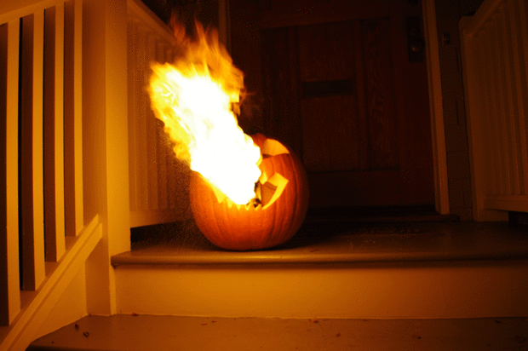
The Cardboard Box for Geeks
Flame throwing Jack O’ Lantern.

Slide 22
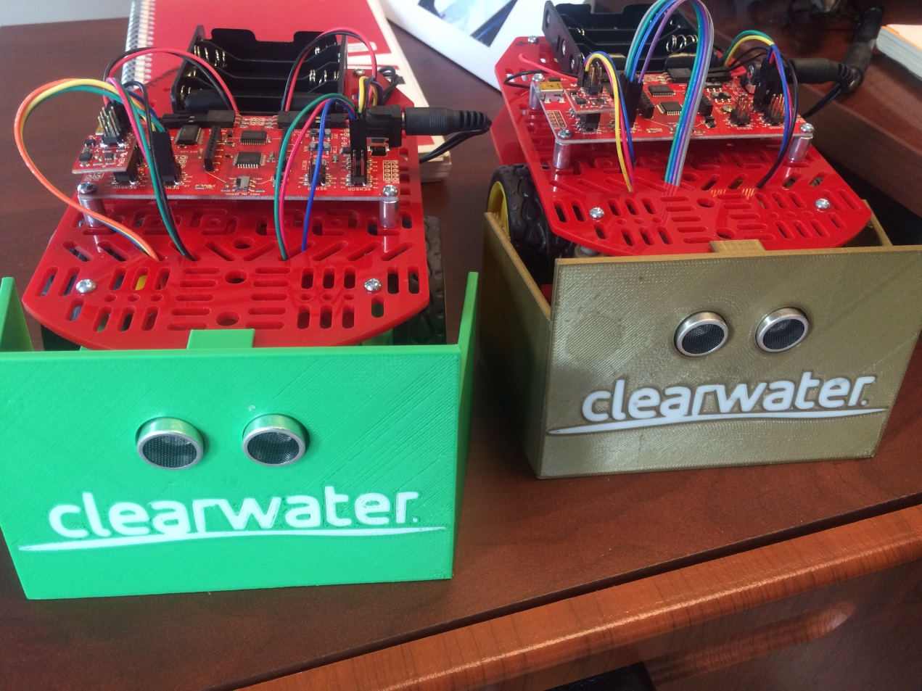
The Cardboard Box for Geeks
SUMO BOTS!

Slide 23
Robot
Hardware
Microprocessor
Sensors
Motors
Power
Software

Slide 24
GeeDee bot
Hardware
Microprocessor
Adafruit Pro Trinket – 5V
Sensors
Motors
Power
Software
Arduino IDE

Slide 25
Robot
Hardware
Microprocessor
Sensors
Motors
Power
Software

Slide 26
Sensors
Movement
Distance
Light
Environment

Slide 27
Movement Sensors
Accelerometer
How fast?
Gryo
Tilt & Direction
Compass
Direction
Proximity
Detect movement

Slide 28
Distance Sensors
Ultrasonic
Uses sound waves
Laser
Uses laser light
Encoder
Revolutions

Slide 29
Light Sensors
Reflectance
Amount of light
Color
Wavelength

Slide 30
Environment Sensors
Temperature
Humidity
Gas

Slide 31
GeeDee bot
Hardware
Microprocessor
Adafruit Pro Trinket – 5V
Sensors
HC-SR04 Ultrasonic Sensor
Motors
Power
Software
Arduino IDE

Slide 32
Robot
Hardware
Microprocessor
Sensors
Motors
Power
Software

Slide 33
Motors
Electric
Stepper
Servo

Slide 34
Electric Motors
Voltage (3 – 6 V)
RPM
Gearing
Controller

Slide 35
Stepper Motors
Precise movement
Current Draw
Driver
Voltage (12V +)

Slide 36
Servo Motors
Limited movement
Continuous Rotation
Signal Pulse

Slide 37
GeeDee bot
Hardware
Microprocessor
Adafruit Pro Trinket – 5V
Sensors
HC-SR04 Ultrasonic Sensor
Motors
Continuous Rotation Servos
Power
Software
Arduino IDE

Slide 38
Robot
Hardware
Microprocessor
Sensors
Motors
Power
Software

Slide 39
Power
Batteries
USB

Slide 40
GeeDee bot
Hardware
Microprocessor
Adafruit Pro Trinket – 5V
Sensors
HC-SR04 Ultrasonic Sensor
Motors
Continuous Rotation Servos
Power
Batteries (4 – AA)
Software
Arduino IDE

Slide 41
Connecting the Parts

Slide 42
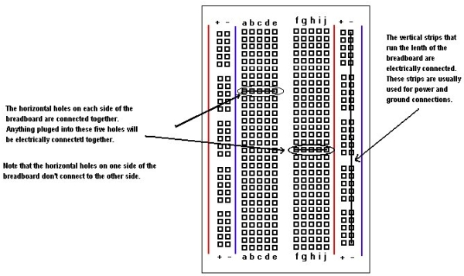
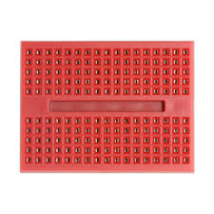
Solderless Breadboard

Slide 43
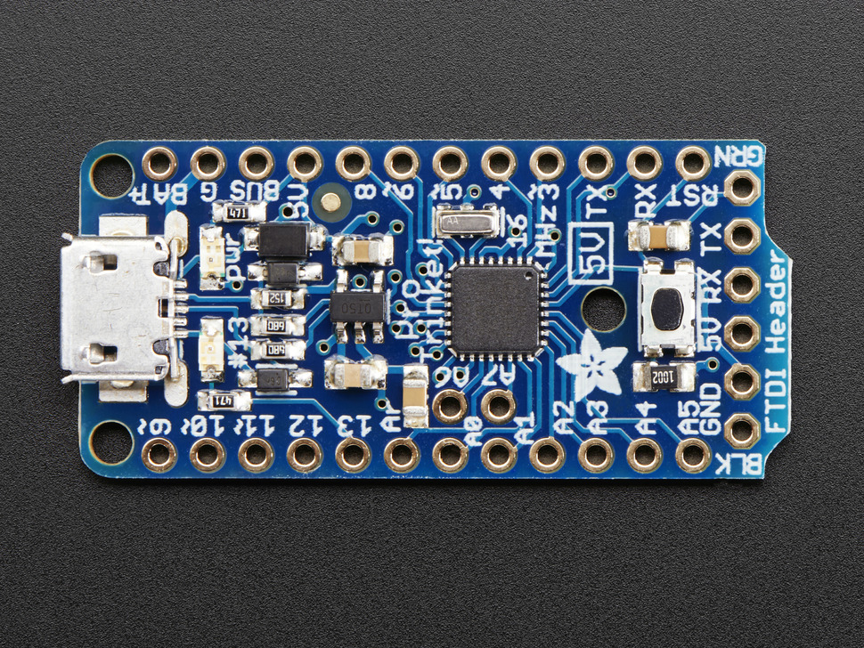
Adafruit Pro Trinket

Slide 44
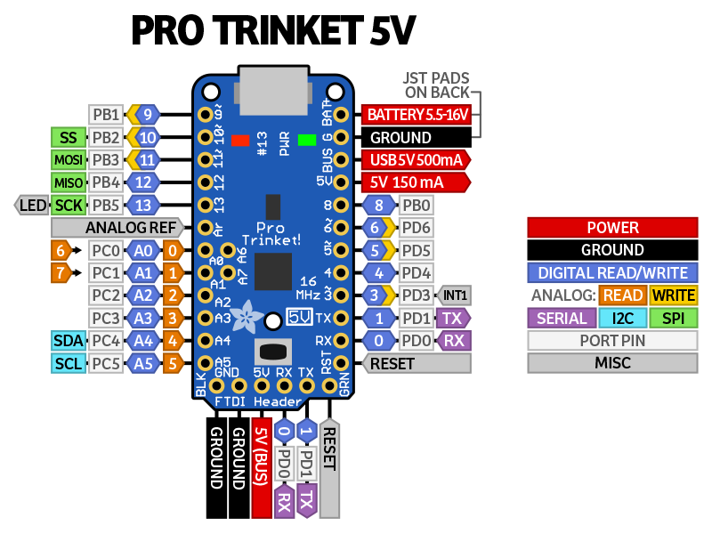
Adafruit Pro Trinket

Slide 45
Adafruit Pro Trinket
Power,
Ground
Servos
Sensor

Slide 46
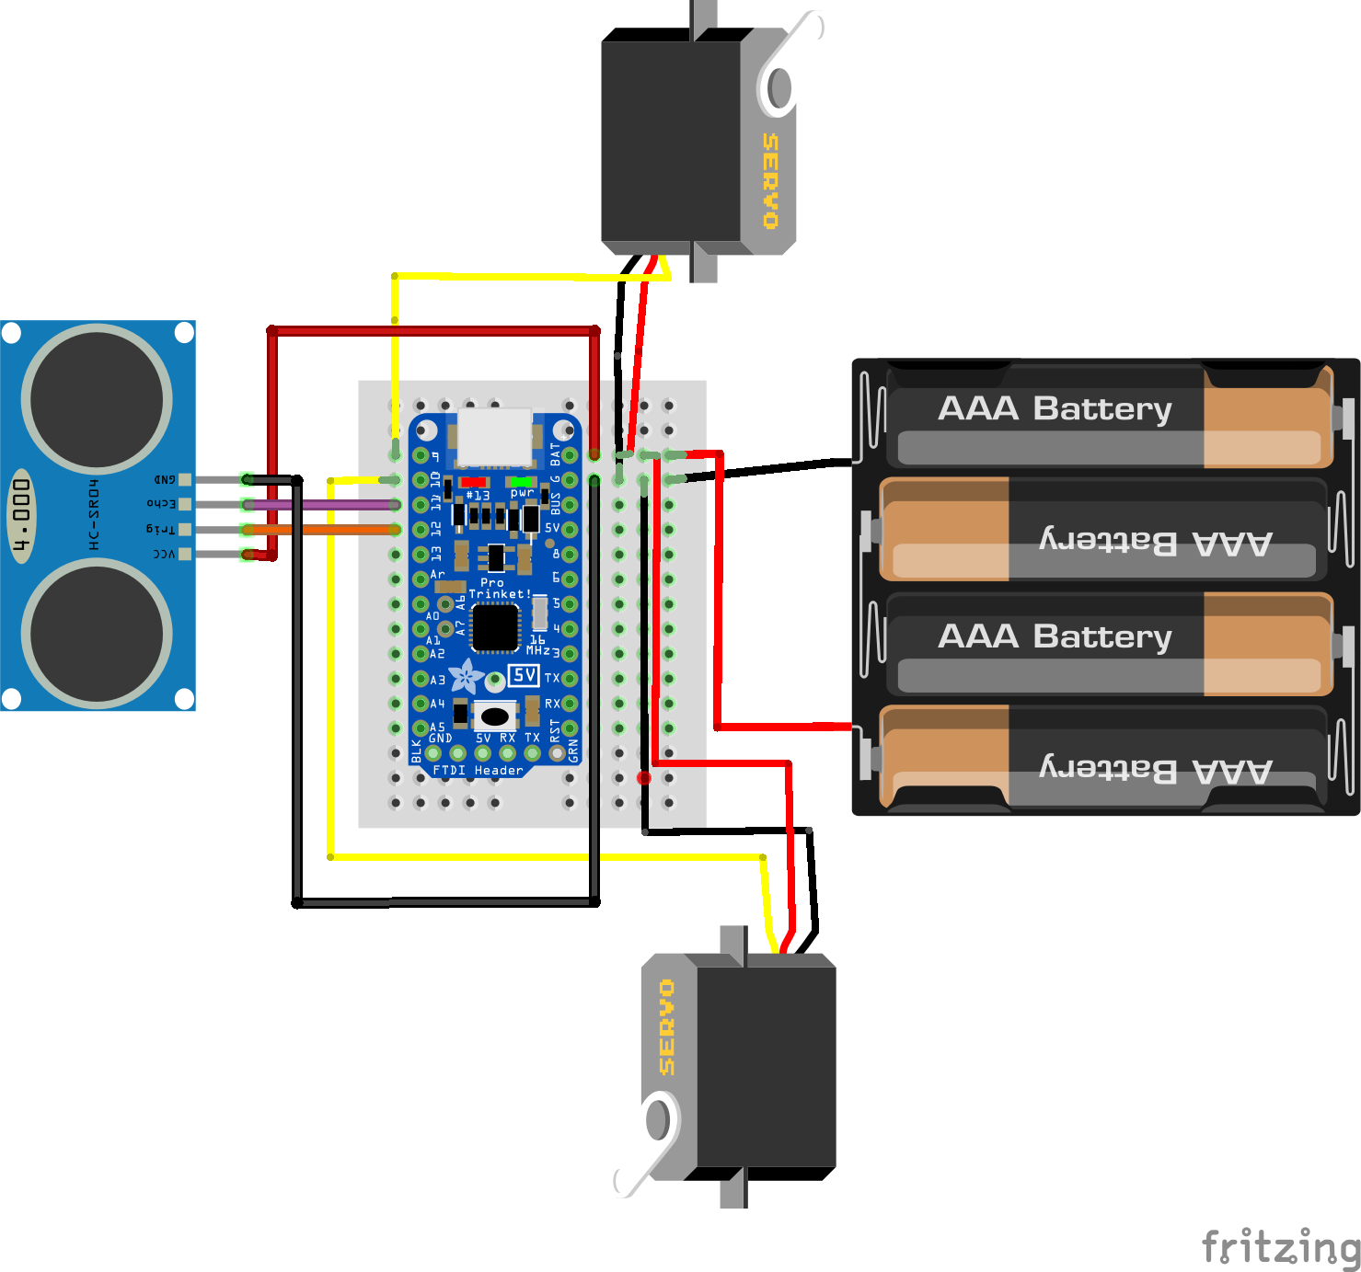
Wiring Diagram

Slide 47
Power
Batteries
USB

